Slide 1

THE SMART GYM

Slide 2
THE SMART GYM
FITNESS CENTER UTILIZATION & EQUIPMENT TRACKING SYSTEM
Smart Gym Management for Campuses
👤 UTTAM CHAURASIA
👤 GOVINDA SHARMA
👤 VATSALYA SINGH
👤 GAURAV KUMAR
📍 HACKATHON| 2026

Slide 3
FITNESS CENTER UTILIZATION & EQUIPMENT TRACKING SYSTEM
Smart Gym Management for Campuses
👤 UTTAM CHAURASIA
👤 GOVINDA SHARMA
👤 VATSALYA SINGH
👤 GAURAV KUMAR
📍 HACKATHON| 2026
THE SMART GYM
THE PROBLEM
⏰ Peak hours overcrowded from 5Pm to 8Pm
Campus gyms face overcrowding and inefficiency due to the
lack of real-time capacity and equipment tracking. Students cannot
check availability in advance, and administrators lack data for
maintenance and resource optimization, leading to poor user
experience and underutilized facilities.
Student walks to the gym but finds no machines available,
resulting in wasted time and disappointment.

Slide 4
FITNESS CENTER UTILIZATION & EQUIPMENT TRACKING SYSTEM
Smart Gym Management for Campuses
👤 UTTAM CHAURASIA
👤 GOVINDA SHARMA
👤 VATSALYA SINGH
👤 GAURAV KUMAR
📍 HACKATHON| 2026
THE PROBLEM
👨‍🎓 Student walks → Gym → ❌ No machines available
⏰ Peak hours overcrowded from 5Pm to 8Pm
🏋️ Morning = Empty gym
THE SMART GYM
PAIN POINTS
STUDENT
ADMIN
No real-time data
No booking system
Time wasted
No usage analytics
No maintenance tracking
Poor planning

Slide 5
FITNESS CENTER UTILIZATION & EQUIPMENT TRACKING SYSTEM
Smart Gym Management for Campuses
👤 UTTAM CHAURASIA
👤 GOVINDA SHARMA
👤 VATSALYA SINGH
👤 GAURAV KUMAR
📍 HACKATHON| 2026
THE PROBLEM
👨‍🎓 Student walks → Gym → ❌ No machines available
⏰ Peak hours overcrowded from 5Pm to 8Pm
🏋️ Morning = Empty gym
THE SMART GYM
OUR SOLUTION
STUDENT
ADMIN
No real-time data
No booking system
Time wasted
✨
No usage analytics
No maintenance tracking
Poor planning
Real-time capacity tracking
📱
Equipment booking
📊
Usage analytics
🛠
Maintenance alerts

Slide 6
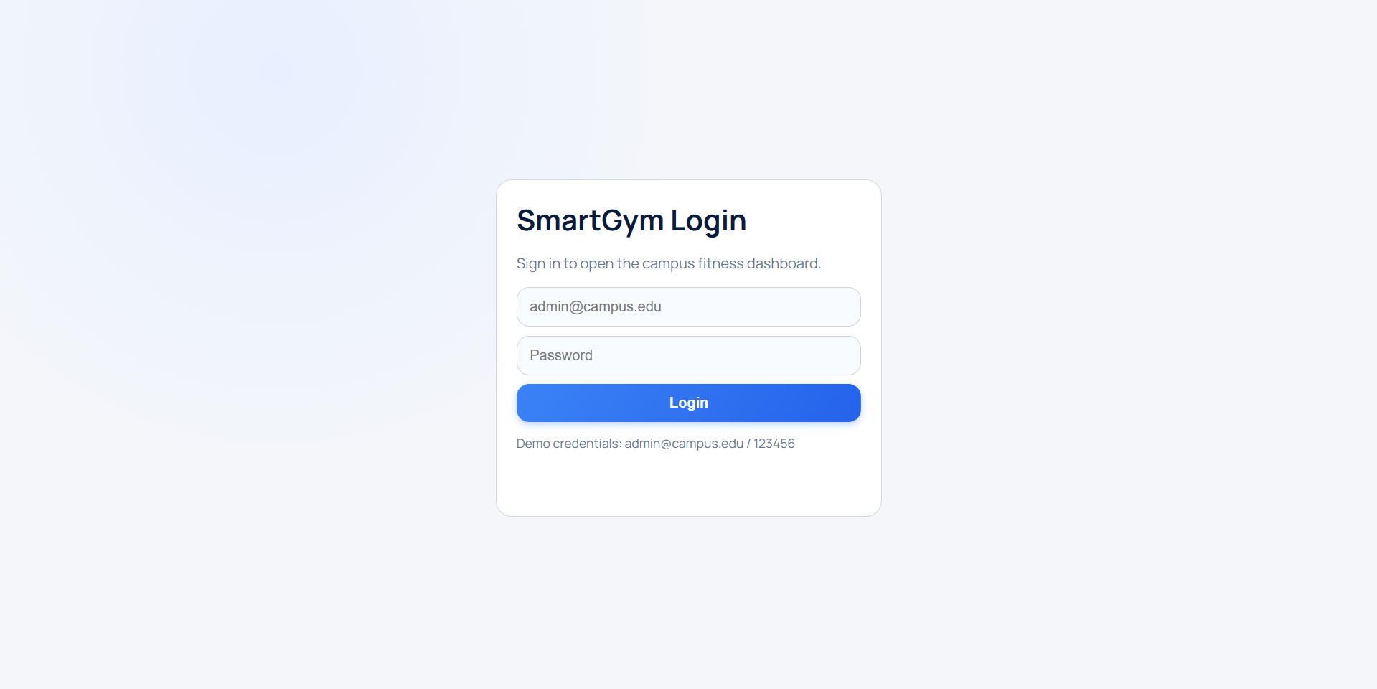
THE SMART GYM
LOGIN

Slide 7
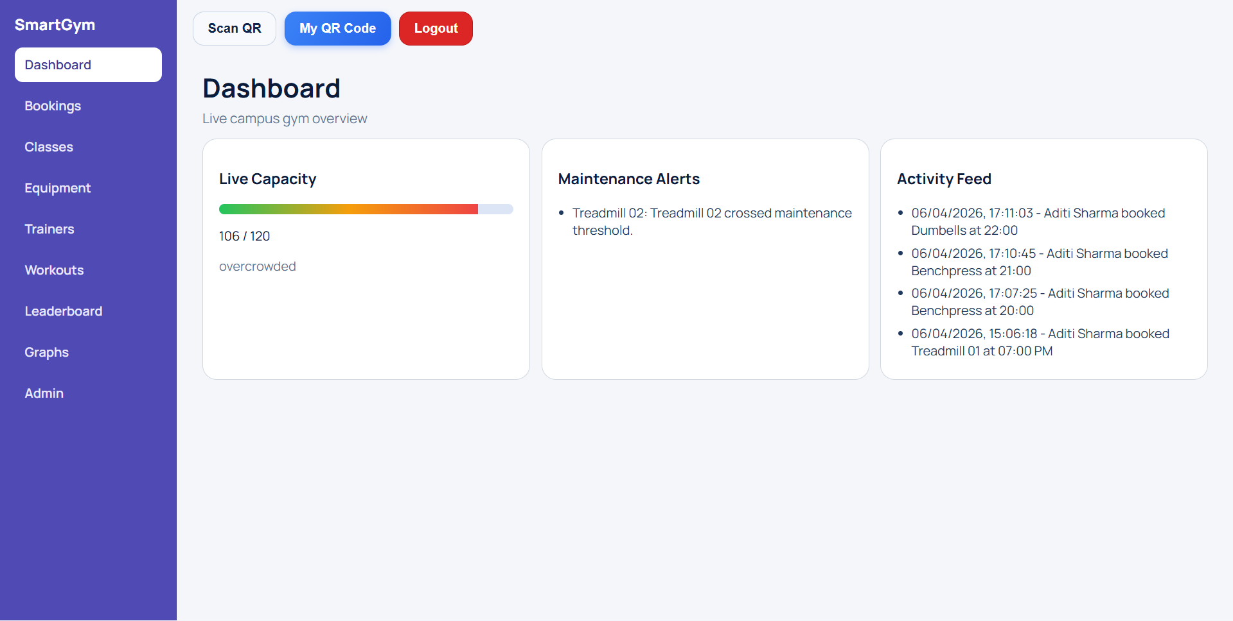

Slide 8
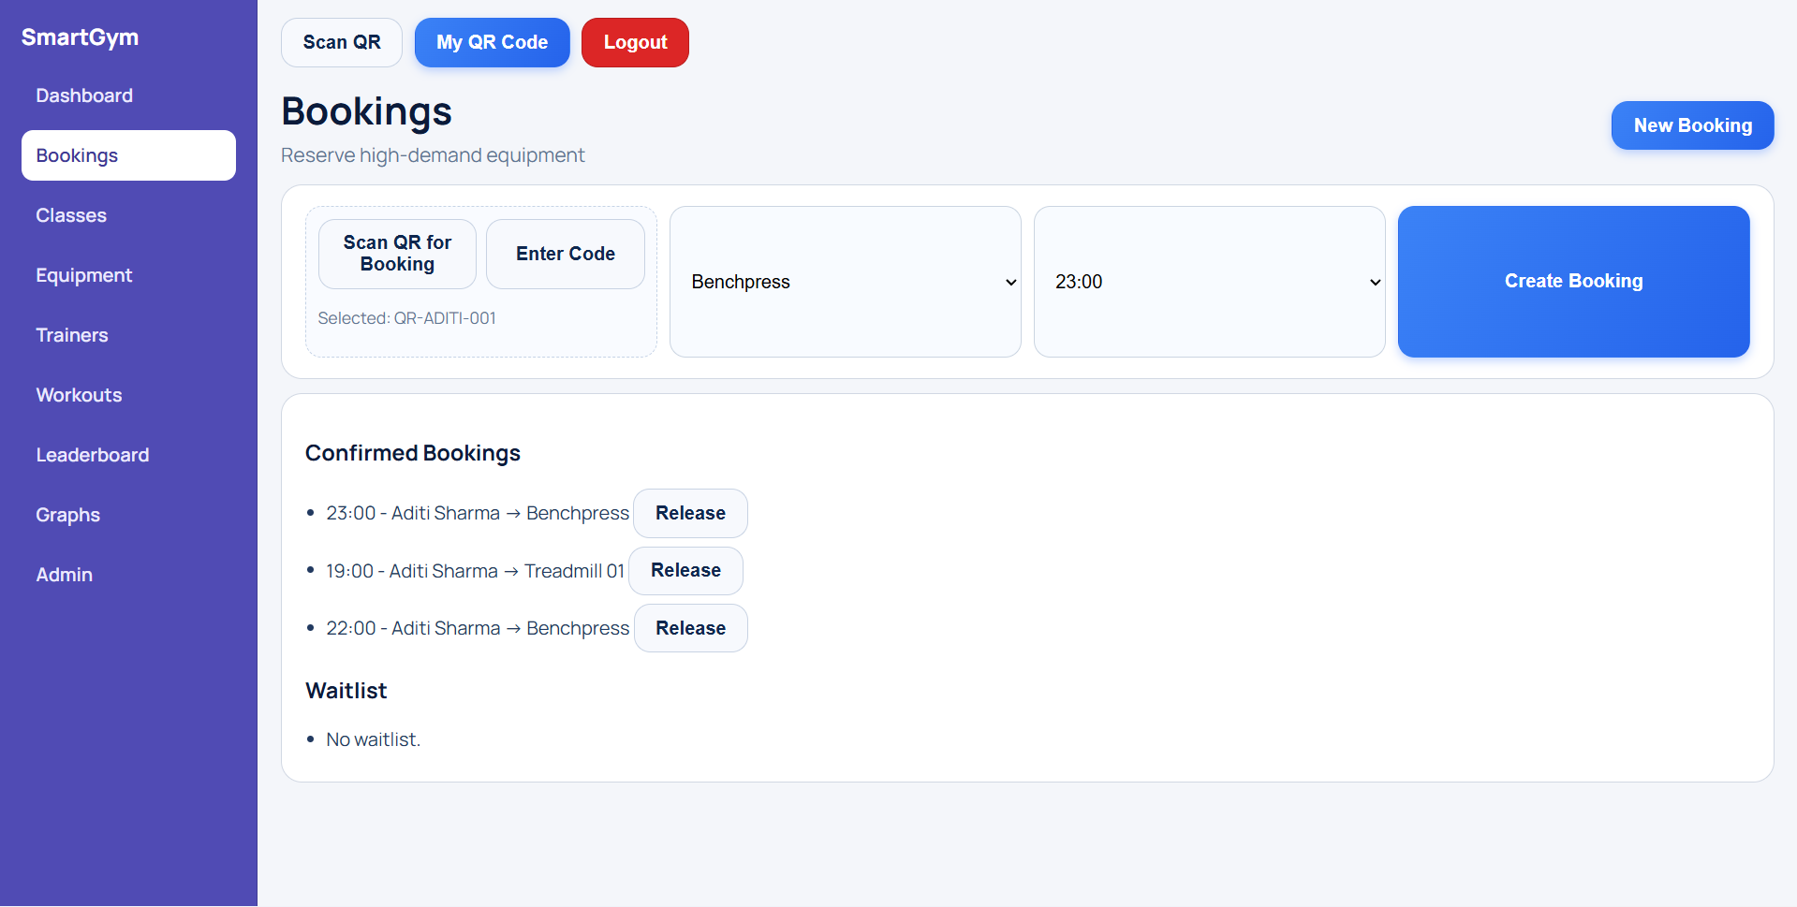
Bookings

Slide 9
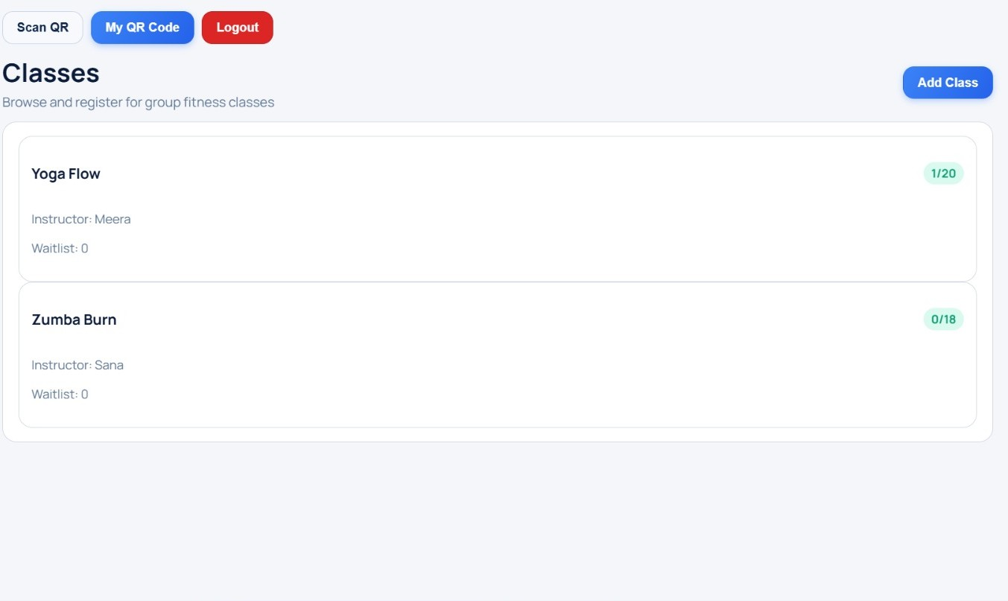
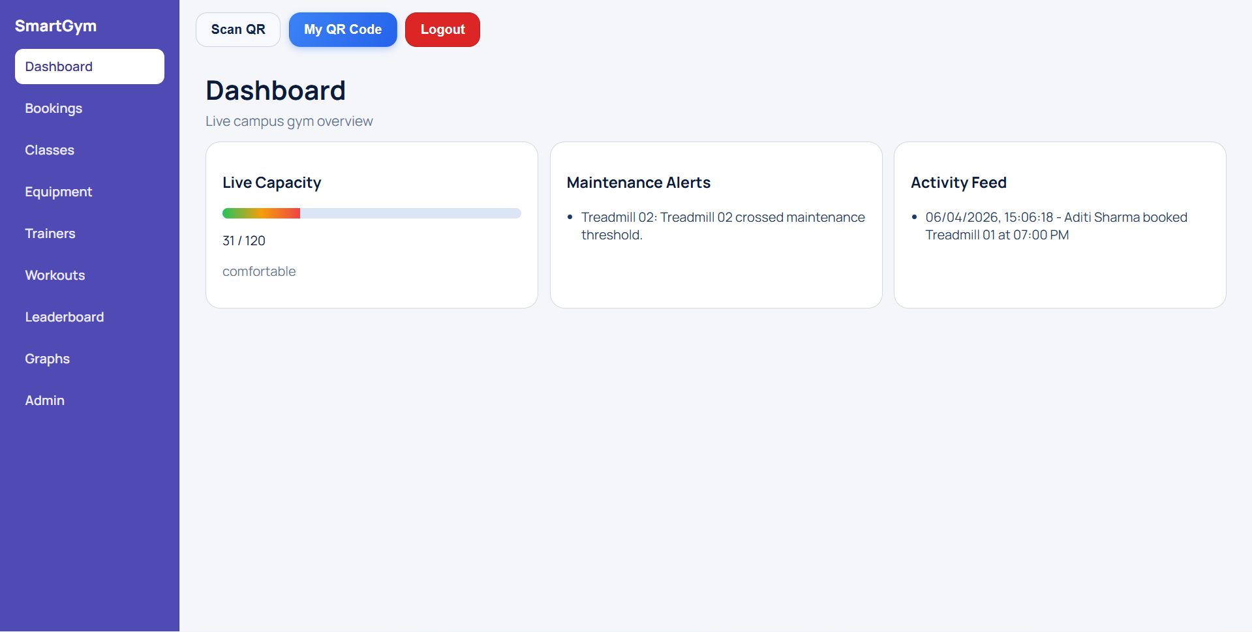
Dashboard
Classes

Slide 10
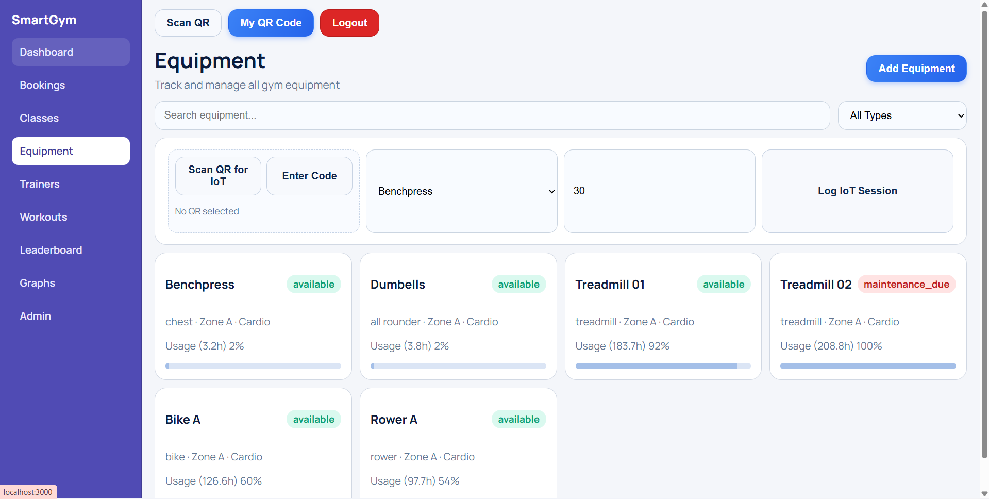
Equipment

Slide 11
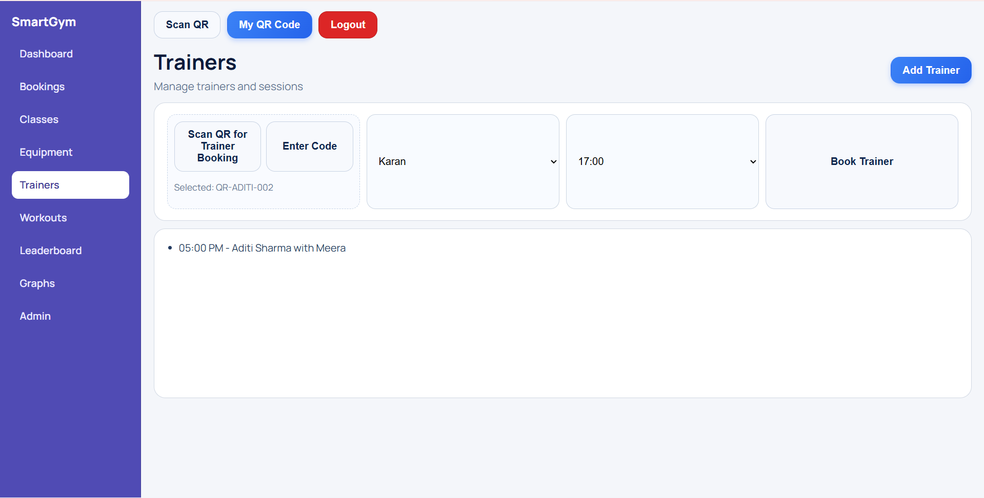
Trainers

Slide 12
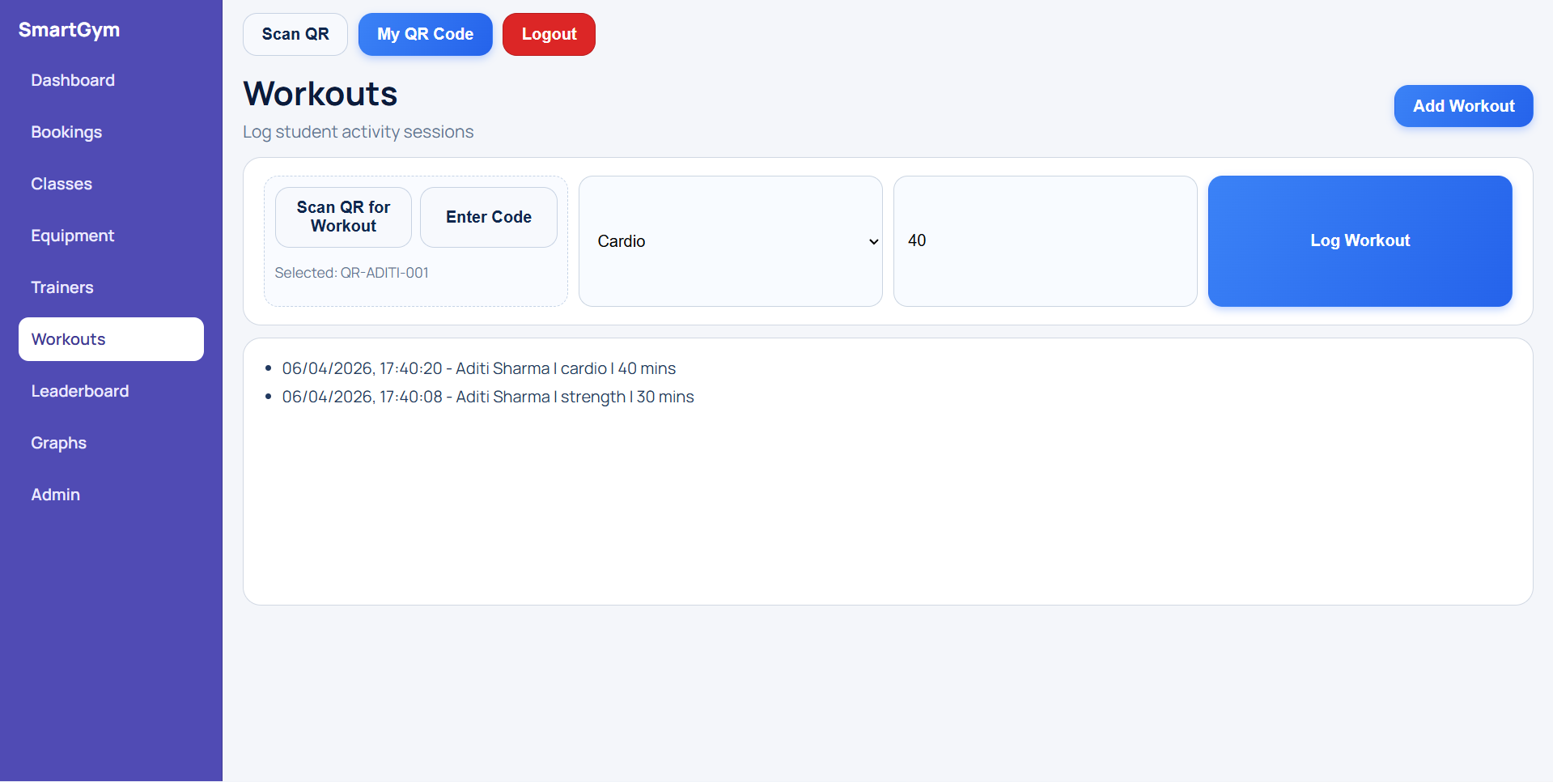
Workouts

Slide 13
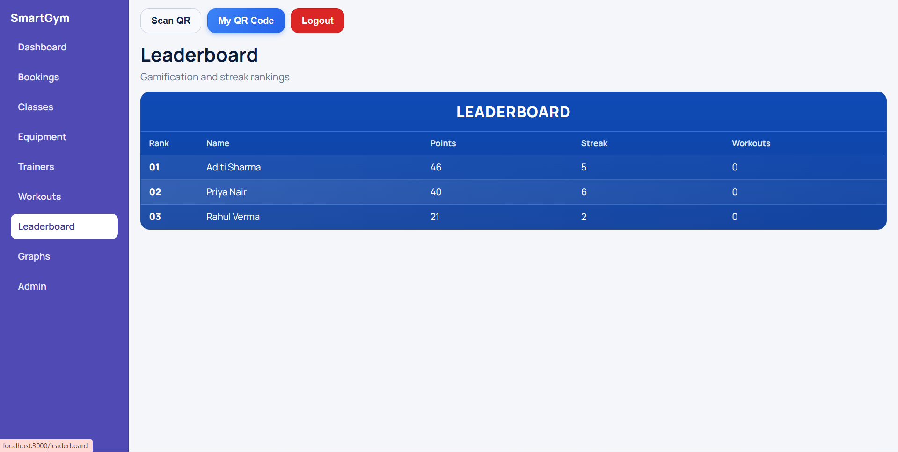
Leaderboard

Slide 14
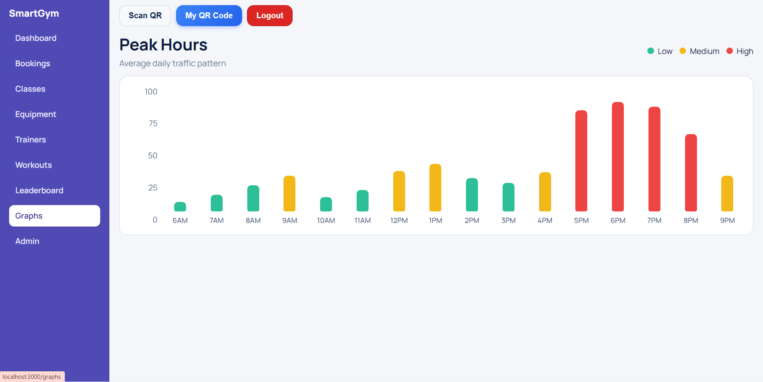
Graphs

Slide 15
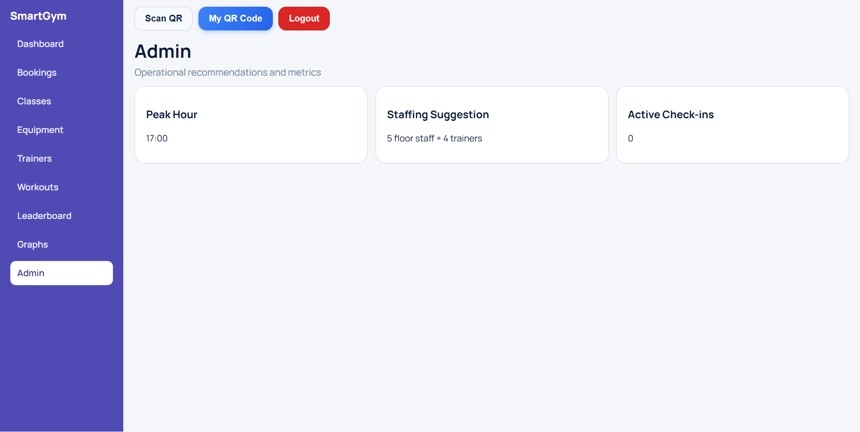
Admin

Slide 16
FITNESS CENTER UTILIZATION & EQUIPMENT TRACKING SYSTEM
Smart Gym Management for Campuses
👤 UTTAM CHAURASIA
👤 GOVINDA SHARMA
👤 VATSALYA SINGH
👤 GAURAV KUMAR
📍 HACKATHON| 2026
THE PROBLEM
👨‍🎓 Student walks → Gym → ❌ No machines available
⏰ Peak hours overcrowded from 5Pm to 8Pm
🏋️ Morning = Empty gym
THE SMART GYM
KEY FEATURES
📊 Capacity Meter
📅 Booking System
🏃 Usage Tracking
🧑‍🏫 Trainer Booking
🧘 Class Registration
🏆 Leaderboards

Slide 17
FITNESS CENTER UTILIZATION & EQUIPMENT TRACKING SYSTEM
Smart Gym Management for Campuses
👤 UTTAM CHAURASIA
👤 GOVINDA SHARMA
👤 VATSALYA SINGH
👤 GAURAV KUMAR
📍 HACKATHON| 2026
THE PROBLEM
👨‍🎓 Student walks → Gym → ❌ No machines available
⏰ Peak hours overcrowded from 5Pm to 8Pm
🏋️ Morning = Empty gym
THE SMART GYM
ARCHITECTURE DIAGRAM
Website
↓
Backend API
↓
Database Server
↓
Admin Dashboard
↓
IoT Simulation → Backend

Slide 18
FITNESS CENTER UTILIZATION & EQUIPMENT TRACKING SYSTEM
Smart Gym Management for Campuses
👤 UTTAM CHAURASIA
👤 GOVINDA SHARMA
👤 VATSALYA SINGH
👤 GAURAV KUMAR
📍 HACKATHON| 2026
THE PROBLEM
👨‍🎓 Student walks → Gym → ❌ No machines available
⏰ Peak hours overcrowded from 5Pm to 8Pm
🏋️ Morning = Empty gym
THE SMART GYM
EQUIPMENT TRACKING
Smart Maintenance System
🏃 Tracks:
Time used
Distance covered
🚨 Trigger:
If limit reached → Alert
👉 Flow:
Machine → Data → System → Alert

Slide 19
FITNESS CENTER UTILIZATION & EQUIPMENT TRACKING SYSTEM
Smart Gym Management for Campuses
👤 UTTAM CHAURASIA
👤 GOVINDA SHARMA
👤 VATSALYA SINGH
👤 GAURAV KUMAR
📍 HACKATHON| 2026
THE PROBLEM
👨‍🎓 Student walks → Gym → ❌ No machines available
⏰ Peak hours overcrowded from 5Pm to 8Pm
🏋️ Morning = Empty gym
THE SMART GYM
FUTURE SCOPE
✨
Crowd maintenance
📡
Real IoT sensors
📱
Wearable integration
🏫
Multi-campus expansion

